Slide 1
MACHINE LEARNING PROJECT FAKE NEWS DETECTION

Slide 2
GROUP - 6

Slide 3
BUSINESS PROBLEM :
To classify if the news is Fake or Real.
OBJECTIVE:
Fake news is the challenging problem in today’s times.
Some individuals are more likely to spread fake news however there is certain regular patterns in Fake news.
Thus we can use Machine learning to identify such patterns and try to predict fake news.

Slide 4
PROJECT STATEMENT
This dataset consists of about 44898 articles consisting of fake as well as real news.
Our aim is train our model so that it can correctly predict whether a given piece of news is real or fake. The fake and real news data is given in two separate datasets with true dataset contains 21417 rows and fake contains 23481 articles each.
Also it consists of 4 columns namely title, subject ,date ,text.

Slide 5
LIBRARIES USED
Pandas
Numpy
Matplotlib
Seaborn
NLTK
Pandas
World Cloud
WordNetLemmatizer
Stop Words
RE
Joblib
Then, Read the Dataset

Slide 6
21,417
NO. OF TRUE AND FAKE NEWS ARTICLES
TRUE/REAL NEWS
FAKE NEWS
23,481

Slide 7
44,898
TOTAL NEWS ARTICLES

Slide 8
PROJECT SECTION
Exploratory Data Analysis (EDA)

Slide 9
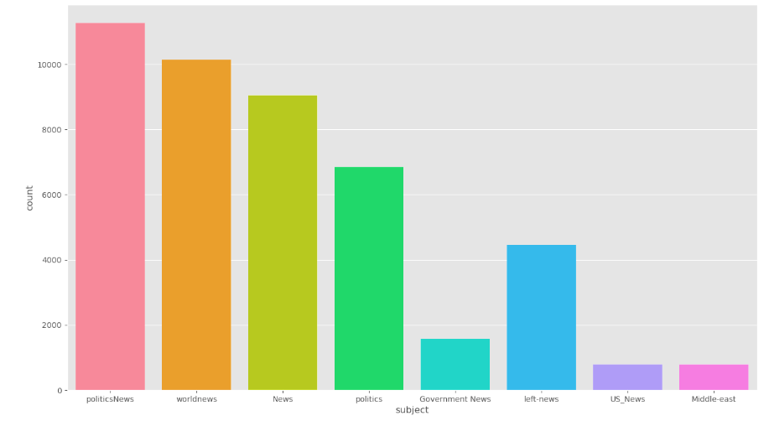
NEWS BASED ON SUBJECT
After merging both the datasets together, it clearly shows that contribution of ‘Politics News’ and ‘world News’ is more in the dataset

Slide 10
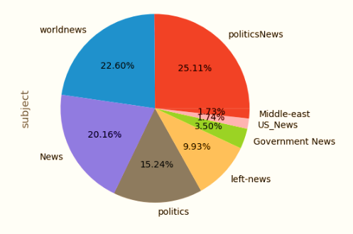
NEWS BASED ON SUBJECT
After merging both the datasets together, it clearly shows that contribution of ‘Politics News’ and ‘world News’ is more in the dataset

Slide 11

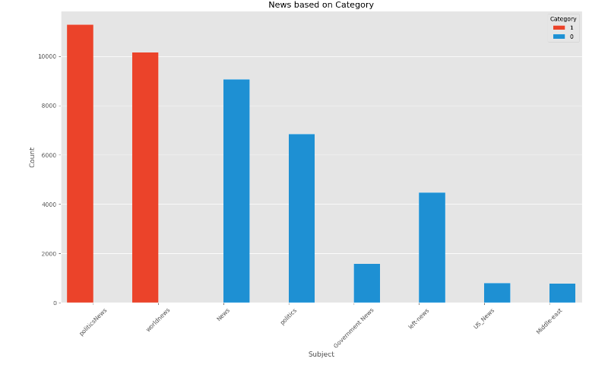
NEWS BASED ON CATEGORY
True Dataset contains articles related to Politics and World news.
Fake Dataset contains articles related to Politics, Government, Left-News, US_News and Middle-East News

Slide 12
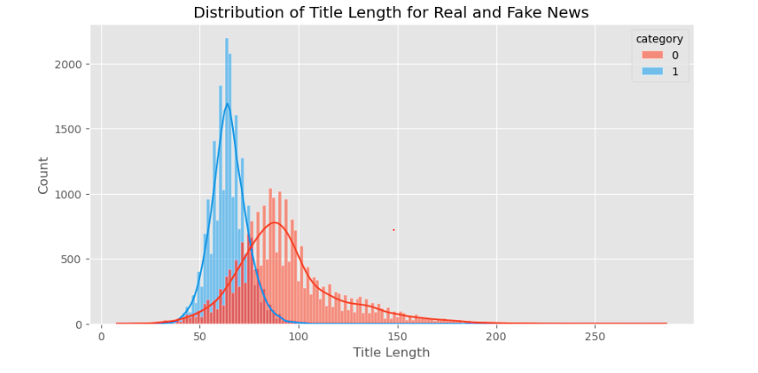
NEWS BASED ON CATEGORY
This histogram shows distribution of title length for both the datasets.
It concludes that length of true news titles is more than fake news titles

Slide 13
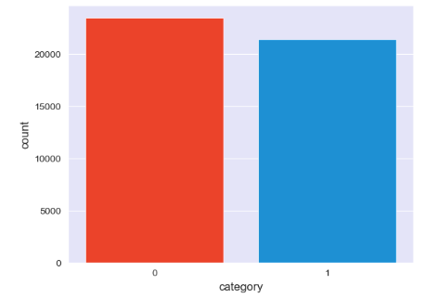
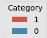
VISUALIZE BALANCING OF NEWS
Contribution of fake news articles is more as compared to true news articles, still data seems to be balanced enough

Slide 14
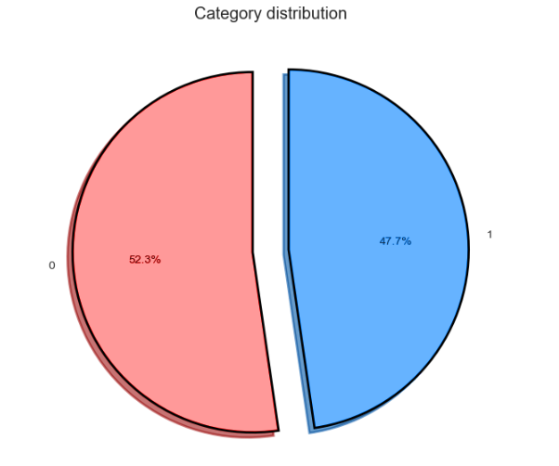
VISUALIZE Contribution OF NEWS
Fake News – 0
True News – 1
This pie chart helps us to understand the contribution of fake and true news articles in the dataset.
Fake news contribution is more when compared to true news

Slide 15
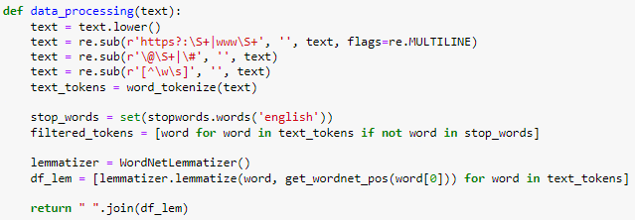
Text Processing
Helps to convert all text to lowercase
Regular Expression helps to remove 'https', 'www‘ unwanted urls from the text
Regular Expression helps to remove unwanted symbols and hashtags
Regular Expression helps to remove unwanted punctuations
Tokenization helps to split words into individual words
This will join the filtered text in to a single string

Slide 16
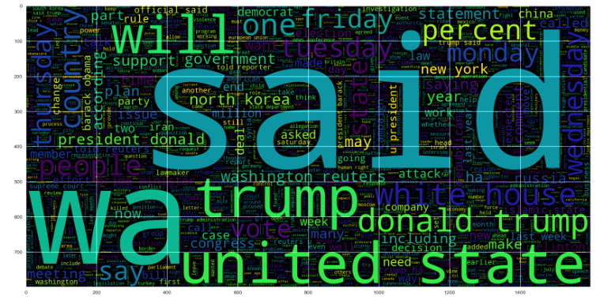
VISUALIZE FREQUENTLY USED WORDS IN TRUE NEWS ARTICLES
This World cloud shows, which are the most frequently used words available in True news articles.
As we can see, SAID, UNITED, STATE, PERCENT, WILL, TRUMP, DONALD are the most frequently used words

Slide 17
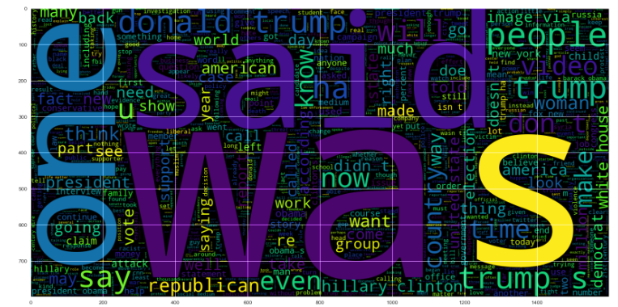
VISUALIZE FREQUENTLY USED WORDS IN FAKE NEWS ARTICLES
This World cloud shows, which are the most frequently used words available in Fake news articles.
As we can see, SAID, ONE, WAS, PEOPLE, TRUMP, SAY are the most frequently used words

Slide 18
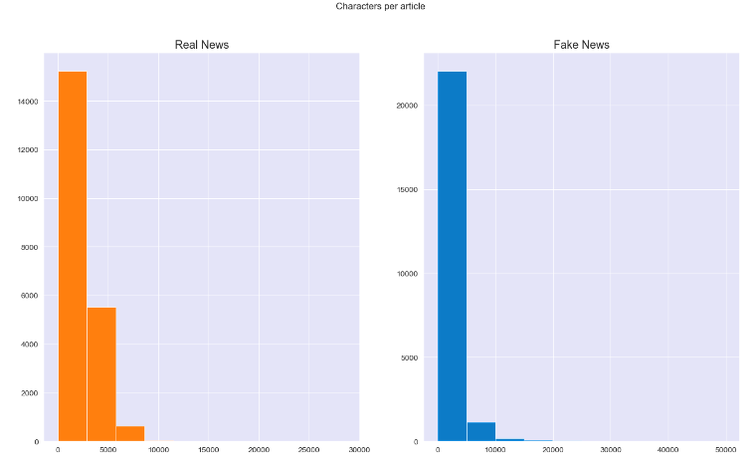
VISUALIZE NUMBER OF CHARACTERS AVAILABLE IN TRUE AND FAKE NEWS ARTICLES
This graph to shows number of available characters in True/Real and Fake news
By looking at the graph it seems like 5000 or less characters in the text are more common in True/Real News where # 10000 or less characters are most common in Fake news

Slide 19
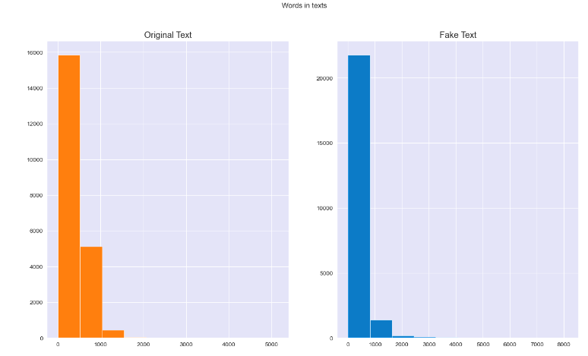
VISUALIZE NUMBER OF TEXTS AVAILABLE IN TRUE AND FAKE NEWS ARTICLES
Graph shows no. of original and fake texts available in both True/Real and Fake news

Slide 20
PROJECT SECTION
Model Building

Slide 21
MODELS USED
We trained our dataset using different classification methods, as mentioned below
Logistic Regression
Random Forest
Ridge Classifier
98.86%
99.74%
Gradient Boosting
99.40%
Support Vector Machine
Decision Tree Classifier
Naïve Bayes
99.52%
99.47%
93.43%
99.55%

Slide 22
NAIVE BAYES CLASSIFIER
Accuracy – 93.43%
Naïve Bayes
93.43%

Slide 23
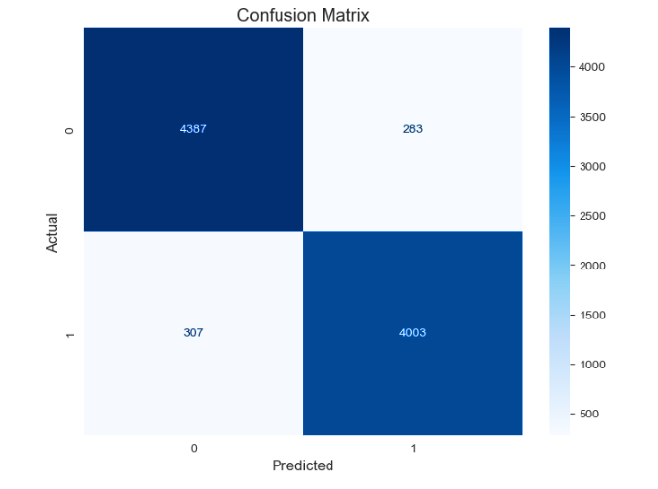
CONFUSION MATRIX FOR NAIVE BAYES
0 - 4387 were fake articles and the model also predicted it as fake
0 - 283 articles were fake however model predicted as Real
1 - 307 articles were real however predicted as fake
1 - 4003 articles were real and predicted as real

Slide 24
LOGISTIC REGRESSION
Logistic Regression
98.86%
Accuracy – 98.86%

Slide 25
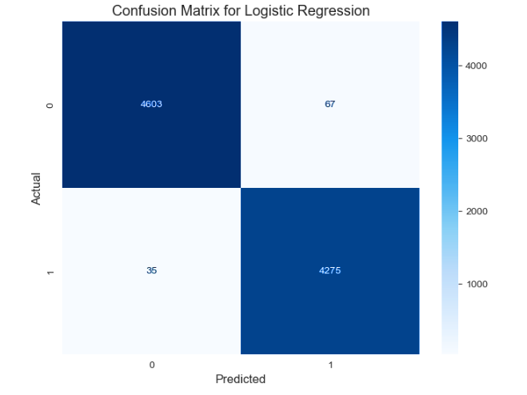
CONFUSION MATRIX FOR LOGISTIC REGRESSION
0 - 4603 were fake articles and the model also predicted it as fake
0 - 67 articles were fake however model predicted as Real
1 - 35 articles were real however predicted as fake
1 - 4275 articles were real and predicted as real

Slide 26
SUPPORT VECTOR MACHINE (SVM) CLASSIFFIER
Support Vector Machine
Accuracy – 99.55%
99.55%

Slide 27
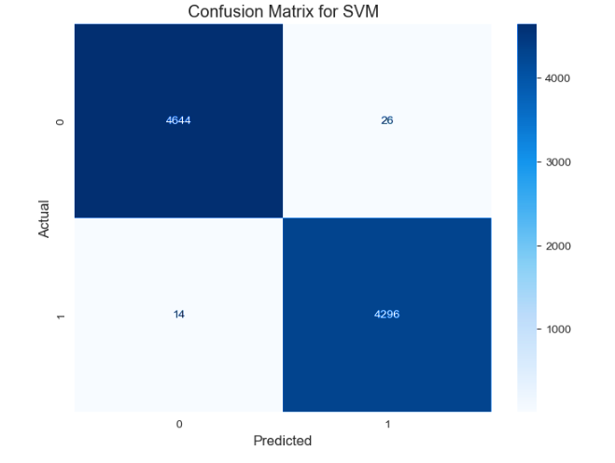
CONFUSION MATRIX FOR SVM CLASSIFIER
0 - 4644 were fake articles and the model also predicted it as fake
0 - 26 articles were fake however model predicted as Real
1 - 14 articles were real however predicted as fake
1 - 4296 articles were real and predicted as real

Slide 28
RANDOM FOREST
Random Forest
99.74%
Accuracy – 99.74%

Slide 29

CONFUSION MATRIX FOR RANDOM FOREST
0 - 4661 were fake articles and the model also predicted it as fake
0 - 9 articles were fake however model predicted as Real
1 - 14 articles were real however predicted as fake
1 - 4296 articles were real and predicted as real

Slide 30
GRADIENT BOOST
Gradient Boosting
Accuracy – 99.52%
99.52%

Slide 31
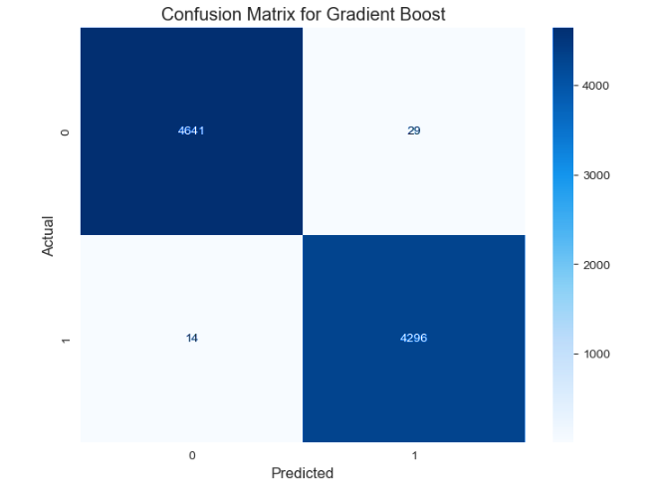
CONFUSION MATRIX FOR GRADIENT BOOST
0 - 4641 were fake articles and the model also predicted it as fake
0 - 29 articles were fake however model predicted as Real
1 - 14 articles were real however predicted as fake
1 - 4296 articles were real and predicted as real

Slide 32
RIDGE CLASSIFIER
Ridge Classifier
99.40%
Accuracy – 99.40%

Slide 33
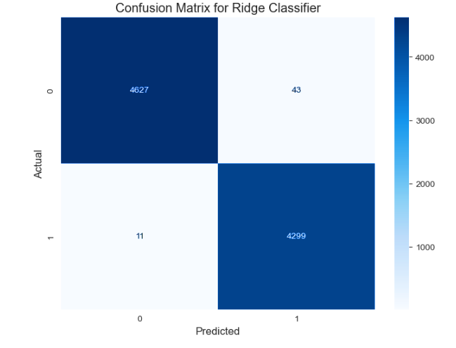
CONFUSION MATRIX FOR RIDGE CLASSIFIER
0 - 4627 were fake articles and the model also predicted it as fake
0 - 43 articles were fake however model predicted as Real
1 - 11 articles were real however predicted as fake
1 - 4299 articles were real and predicted as real

Slide 34
DECISION TREE
Decision Tree Classifier
Accuracy – 99.47%
99.47%

Slide 35
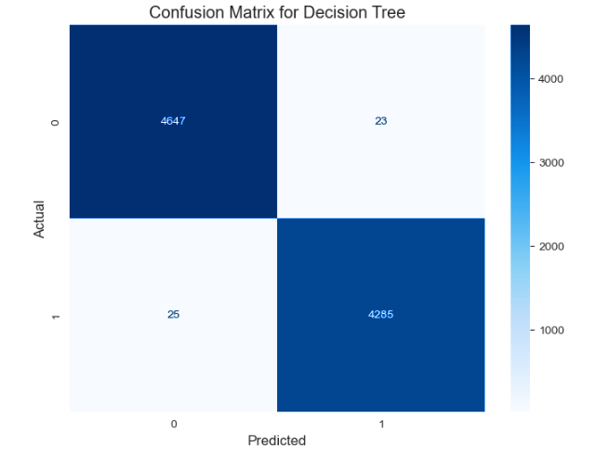
CONFUSION MATRIX FOR DECISION TREE
0 - 4647 were fake articles and the model also predicted it as fake
0 - 23 articles were fake however model predicted as Real
1 - 25 articles were real however predicted as fake
1 - 4285 articles were real and predicted as real

Slide 36
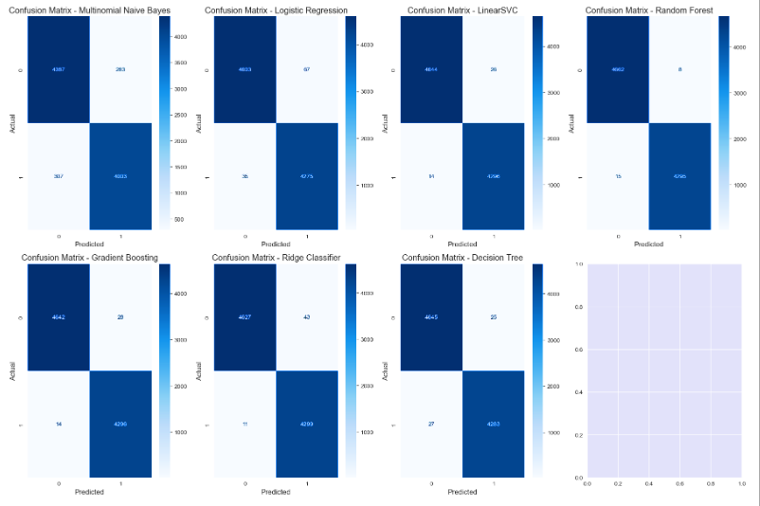
COMBINED CONFUSION MATRIX
This is the combined confusion matrix to differentiate available and predicted news by all the models

Slide 37
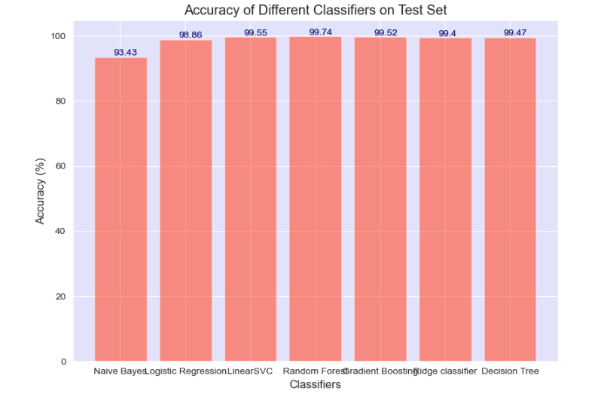
ACCURACY
This bar plot shows accuracy of all models in one frame
As we can see in the graph Random Forest classifier gives the highest accuracy
Hence, Random forest will be our finalized model to move further with our manual testing

Slide 38
MODEL EVALUATION
Manual Testing

Slide 39

MANUAL TESTING
Above is the snippet to check or test the news if it is predicting it correctly.
This will also helps us to understand if our model has been trained properly
Manual testing can help assess the model's confidence levels, particularly in cases where the model may be uncertain about a news article's classification.
Manual testing is an ongoing process, and its findings contribute to a feedback loop for iterative model improvement over time.

Slide 40
MODEL DEPLOYMENT
News Prediction

Slide 41
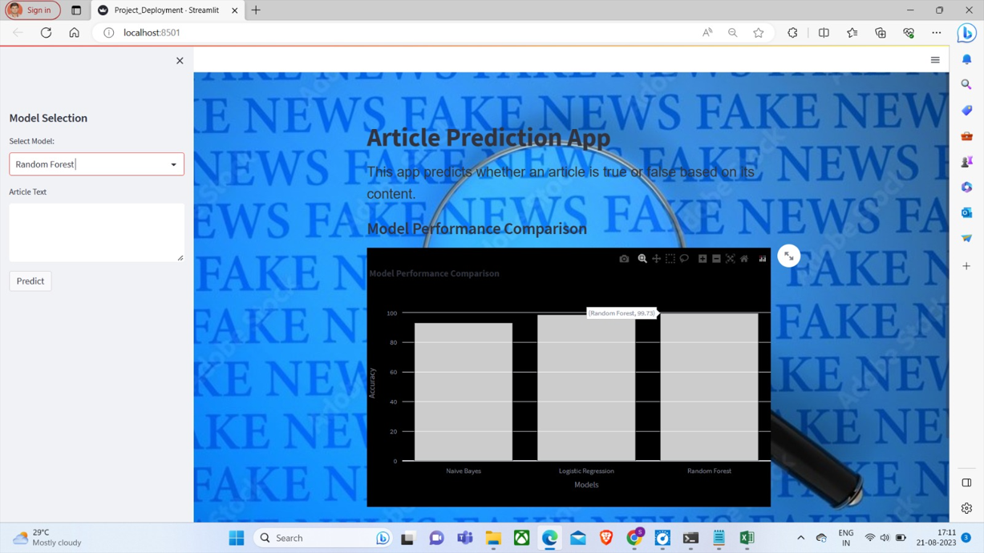
WEBPAGE
This is how the page of our deployment webpage looks like
Model Selection : Where we have an option to select different models to predict the news articles if it is fake or real base on different algorithm
Article Text: To enter news articles for predictions
Once news articles entered press Predict button to view the results

Slide 42

FINAL WEBPAGE TO PREDICT NEWS
Once the news article is been entered it shows if the news is real or fake
Also, this webpage has been created in such a way that it shows prediction outcome along with prediction probability
This webpage also shows couple of graphs like world cloud and bar graph.
Bar graph shows the percentage of probability based on different algorithms or models

Slide 43
CHALLENGES FACED
Getting words in to its base format
System Slowness / compatibility Issue
Waiting long time for hyper parameter tuning
Decide which graph to use for visualization

Slide 44
HOW DID WE OVERCOME CHALLENGES FACED
Earlier we decided to use port stemmer which will help us to convert all the words in to its base format however when we executed the function then the results were not that good what was required, later we did some research and decided to go with lemmatization and yes the results came out to be good.
When we started executing our functions, normal functions were executing very fast however when it comes to visualization or any kind of long function it used to take very long to execute, then we as a group used to get on call and request everyone to execute the same code in their system and check which one gets executed fast and that is how we overcome this problem
As said earlier, the longest function used to take very long, and it was the same story when it comes to hyper parameter tuning, when we tried executing the function it took so long to execute and we had no option than waiting for it to execute
At the start of this project during EDA section when we have been requested to add more graphs to get more insights about dataset, it was little difficult to chose which graph to add however we did some research with the help of google and able to visualize our dataset.

Slide 45
OUR TEAM
Mayur D
Sarth Naik
R Diwahar
Apoorva
Shivam Jaiswal
Bindhu B N
Kunal Kapse

Slide 46
THANK YOU

